Slide 1

Credit Card Lead Predictions
Pushkar Chougule
This Photo by Unknown Author is licensed under CC BY-NC

Slide 2
Content
Business Problem and Background
Data Explanation and Preparation
Feature Analysis and Methods
Machine Learning Models and Evaluation
Conclusion
Assumptions and Limitations
Future Usage and Recommendations
Ethical Assessment
References

Slide 3
Business Problem and Background
Private bank existing customer base
Product offerings : Checking / Savings accounts, credit cards, loans, investments
Identify Potential customers eligible for Credit Card Products and offer to apply
Revenue Growth with prospective new Credit Card accounts

Slide 4
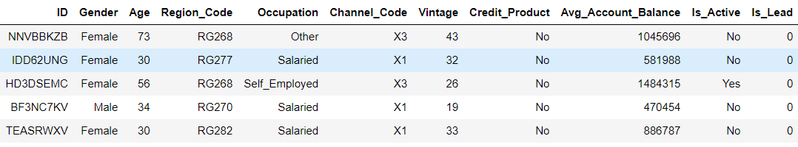
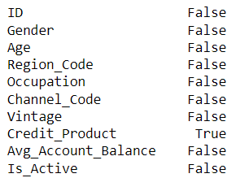
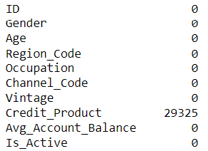
Data Explanation and Preparation
Target
Feature
Features with NULL Values

Slide 5
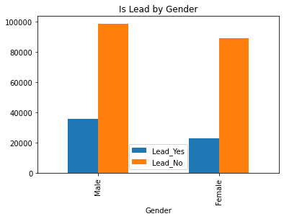
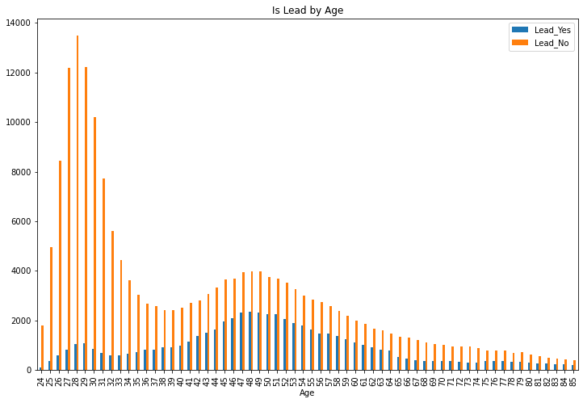
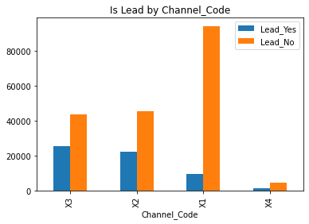
Features Analysis and Methods

Slide 6
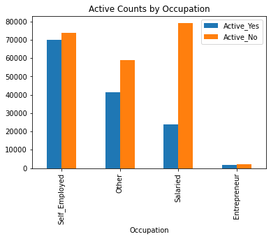
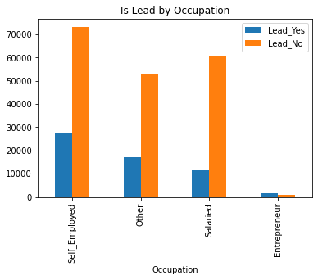
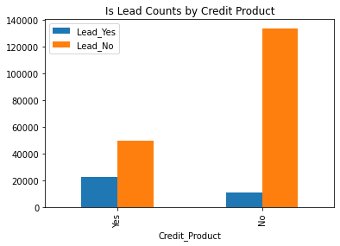
Features Analysis and Methods (continued)

Slide 7
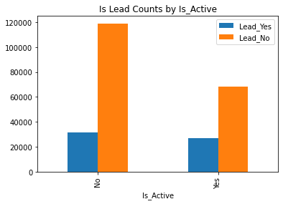
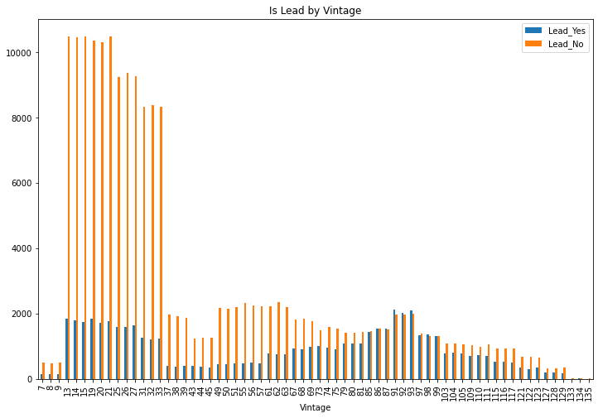
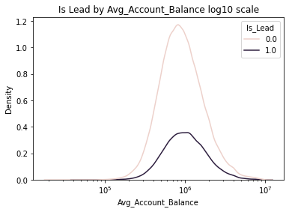
Features Analysis and Methods (continued)

Slide 8


Machine Learning Models and Evaluation
Training results
Logistic Regression
Random Forest Classifier
Gaussian Naïve Bayes
Gradient Boost classifier
ADA Boost classifier
XG Boost classifier
Evaluation results

Slide 9
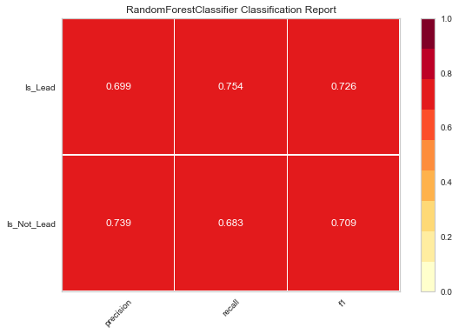

Machine Learning Models and Evaluation (Classification reports)

Slide 10
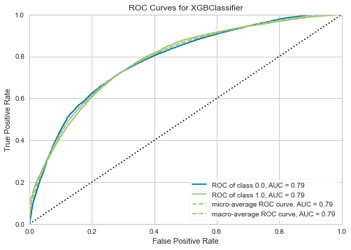
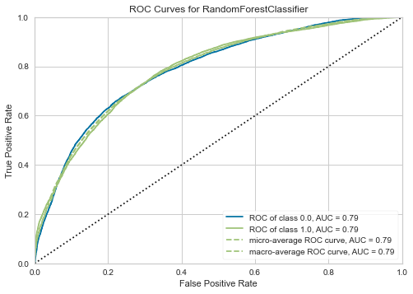
Machine Learning Models and Evaluation (ROC curves)

Slide 11
Conclusion
Certain Age groups showed up as potential candidates along with specific communication channels which were highly effective
Having existing credit products with the bank was a positive influencer for potential leads
Self employed customers came up as high potential leads as compared to entrepreneurs
Vintage turned out to be a handy factor as well along with average account balance
Currently Active Customers stand a good chance of being potential leads
Following the potential prediction leads from the designed system could help expand the credit card customer base and thereby add to the revenue of the bank

Slide 12
Assumptions / Limitations
Assumption: with mostly categorical features – all details captured correctly and no outliers present
Limitation : Imbalanced data due to lower size of training data having potential positive leads as compared to non-leads

Slide 13
Future Usage and Recommendations
The modeling approach can be reused for other product offerings like loans or investment products by capturing relevant additional features
Recommend for future improvements, capture and share credit scores and annual income as factors

Slide 14
References
Kaggle Dataset. https://www.kaggle.com/sajidhussain3/jobathon-may-2021-credit-card-lead-prediction
Gupta, Aman (2021) https://medium.com/geekculture/xgboost-versus-random-forest-898e42870f30
Difference Between Random Forest vs XGBoost https://www.educba.com/random-forest-vs-xgboost/

Slide 15


THANK YOU
This Photo by Unknown Author is licensed under CC BY

